Slide 1
Mean-Variance Portfolio Rebalancing with Transaction Cost
Author: Philip H. Dybvig
Presenter : Jingxuan (April) Zou 463504

Slide 2
Agenda
Introduction
Numerical Analysis for Two Risky Asset
Theoretical Analysis for Single Risky Asset
Conclusion & Discussion
Notes:
Transaction costs can make it unprotable to rebalance all the way to the ideal portfolio. A single-period analysis using mean-variance theory provides many interesting insights.

Slide 3
Introduction

Slide 4
Previous Research
Portfolio rebalancing with transaction costs problem
Portfolio with two assets: continuous-time model + free boundary problem
Portfolio with more assets: multi-asset continuous-time model + extreme case
Mean-variance analysis framework
Markowitz[1952,1959]: basic formulation & quadratic programming tools
Tobin[1958]: macroeconomic implications
Jacob[1974]: number constraint; Brennan[1975]: fixed cost; Mao[1970,1971]: adding securities without modeling the costs
Notes:
Unfortunately, this type of assumption tends to produce a somewhat messy combinatoric problem looking at all possible subsets to include, and their static perspective does not seem suited to questions about rebalancing.

Slide 5
Non-trading region
A general model using matrix algebra accommodates features following:
  Multiple risky assets
  Trading stocks individually/by bundle
  Trading futures and swaps
A set of portfolio positions from which there is no trade that would justify the cost of trading
  Parallelogram: individual stocks + cash settlement
  Rectangle/Square：uncorrelated returns
The non-trading region of one risky asset depends on the positions in the other securities due to correlations
Different boundaries for purchasing and selling because of the wedge
Notes:
If all trade is in individual stocks and takes place through cash, which is held as a residual asset, the optimal non-trading region is a parallelogram or its higher dimensional equivalent. If, in addition, asset returns are uncorrelated, the parallelogram becomes a rectangle.
All the solutions feature the concept of a non-trading region, a set of portfolio positions from which there is no trade that would justify the cost of trading.
The boundaries for purchasing and selling are dierent because the costs put a wedge between the marginal valuations at market prices and valuation the prices net of costs.

Slide 6
Numerical Analysis for Two Risky Asset

Slide 7
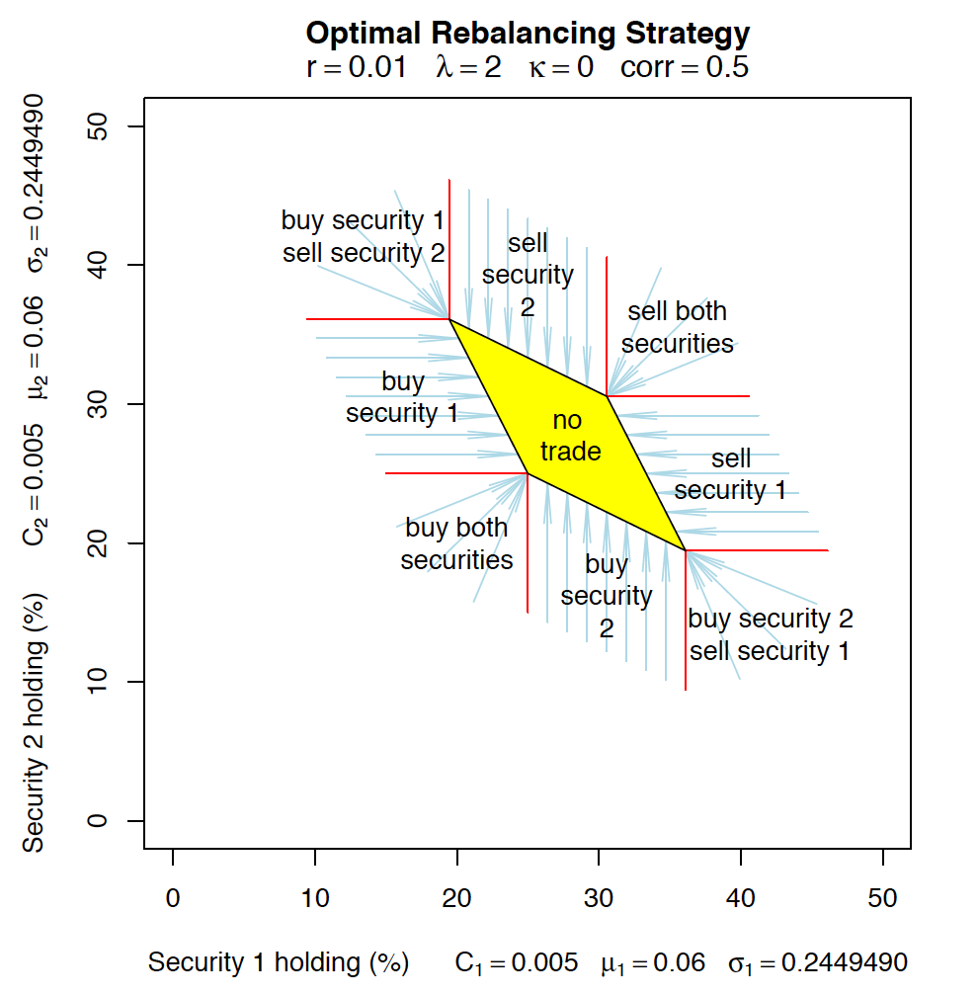
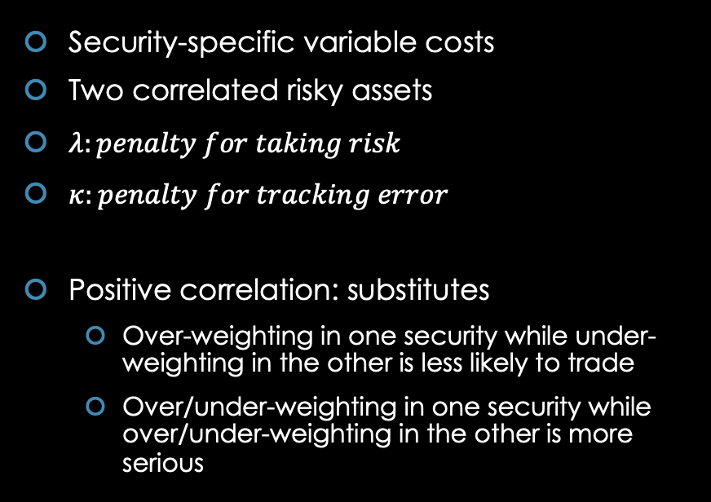
Variable Costs
Security-specific variable costs
Two correlated risky assets
$λ:penalty for taking risk$
$κ:penalty for tracking error$
Positive correlation: substitutes
  Over-weighting in one security while under-weighting in the other is less likely to trade
  Over/under-weighting in one security while over/under-weighting in the other is more serious
Notes:
Over-weighting in one security is less likely to result in a trade if we are under-weighted in the other security.
Over- or under-weighting in one security is more serious if we have the same over- or under-weighting in the other security.
If the initial allocation 0 is in the non-trading region, shaded in yellow, then there is no trade whose bene t covers the cost and it is best notto trade. The right boundary of the non-trading region is part of the line along which we are just indierent about selling Security 1, and it is optimal to sell Security 1 if we start to the right of this boundary. The left boundary
of the non-trading region is part of the line along which we are just indierent about purchasing Security 1, and it is optimal to purchase Security 1 if we start from left of this boundary.

Slide 8
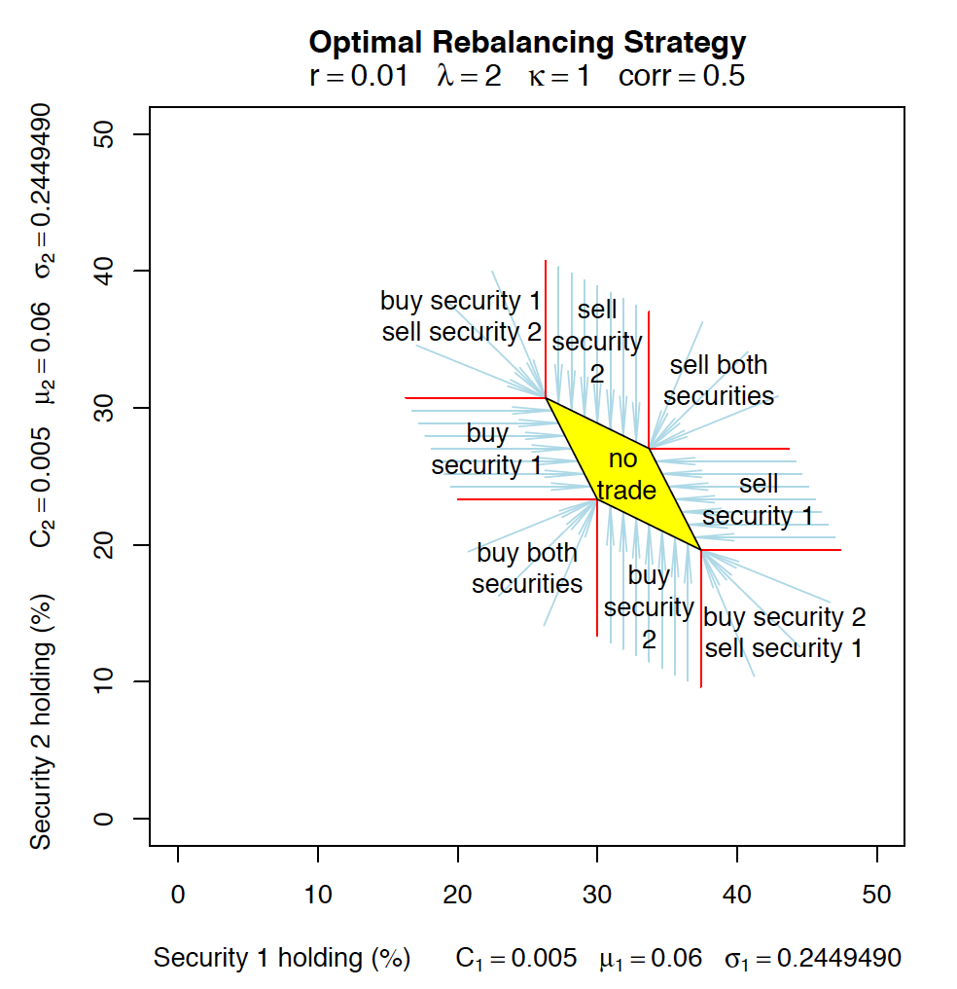
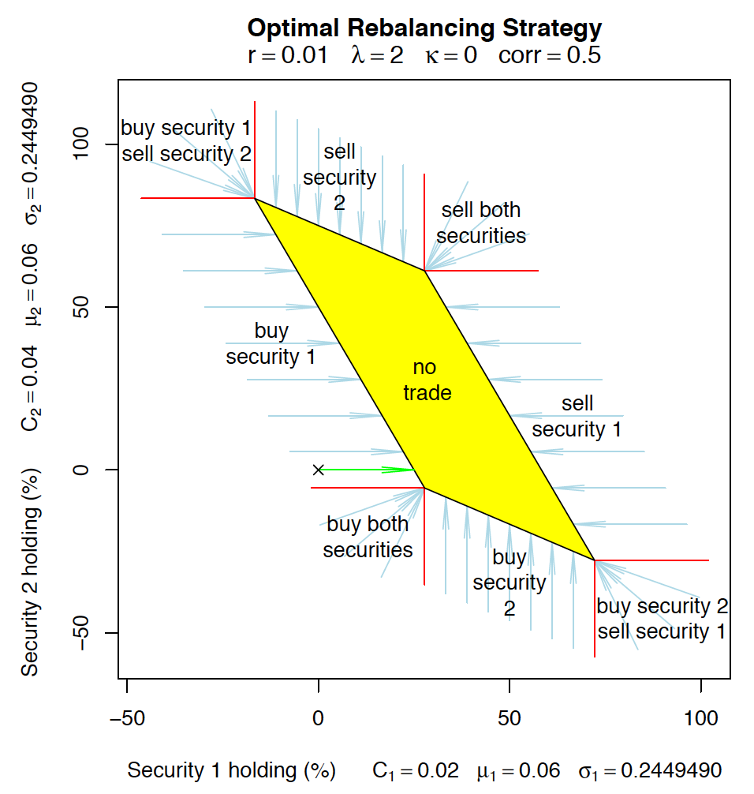
Variable Costs
Notes:
Left: This additional penalty makes the non-trading region smaller and shrinks it towards the benchmark portfolio
Right: increased the cost of trading Security 2. This increases the vertical size of the non-trading region.
A similar result could obtain if Security 2 had more idiosyncratic risk than Security 1.

Slide 9
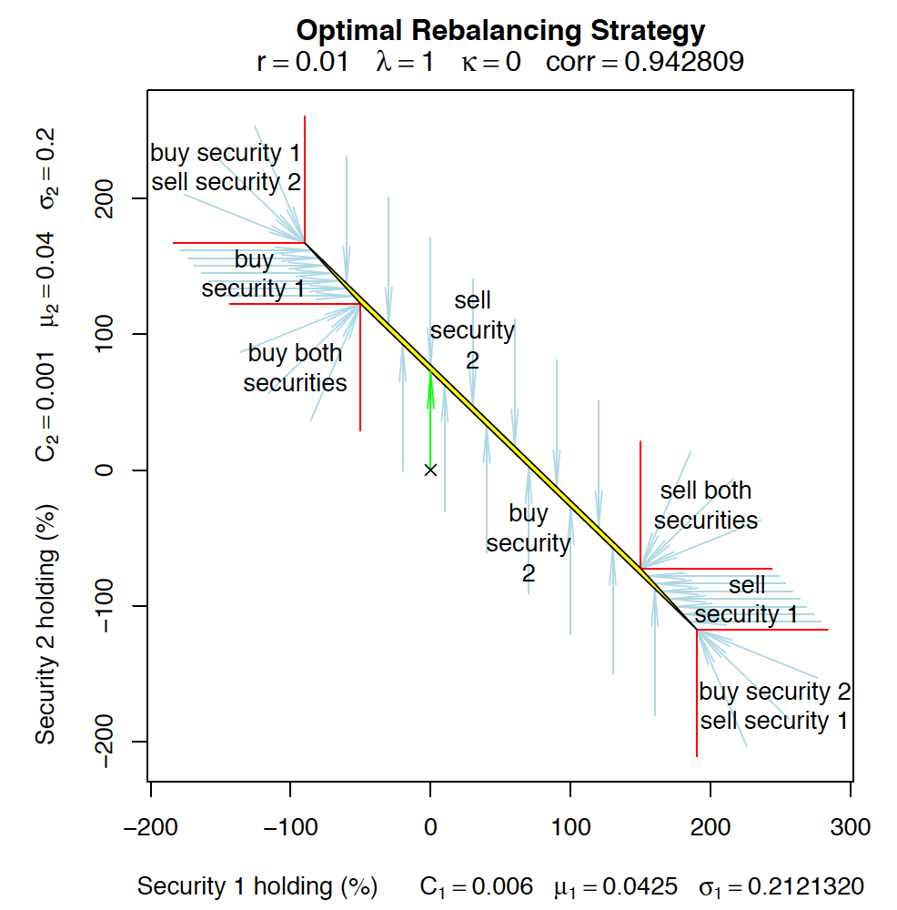
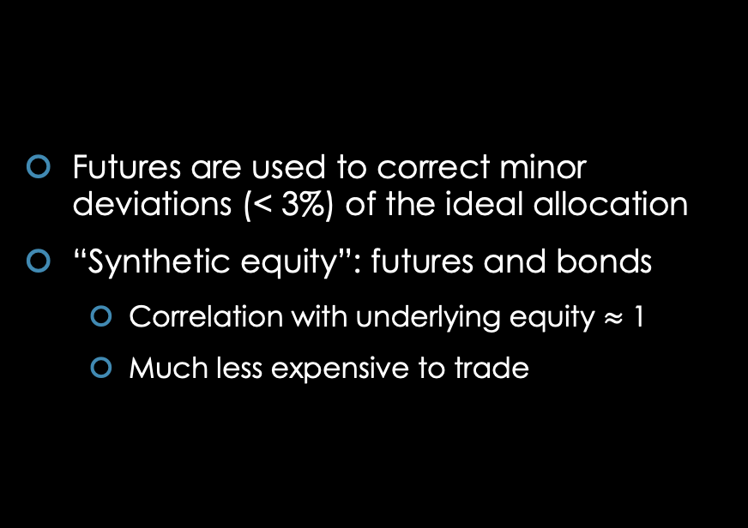
Futures Overlay
Futures are used to correct minor deviations (< 3%) of the ideal allocation
“Synthetic equity”: futures and bonds
  Correlation with underlying equity $≈$ 1
  Much less expensive to trade
Notes:
The analysis here confirms the value of using a futures overlay but suggests an improvement on the traditional form of the strategy.
Security 2: futures, equity-equivalent mean returns are nearly the same
the investor gets nearly the same expected return on the underlying and on \synthetic equity“ composed of futures and investing in the risky asset. In this case, the additional expected return from holding equities is too small to justify the additional transaction costs. Consequently, if we are over- or under-weighted in equities initially (with no futures), we correct our position by selling or buying futures. Thus, in the absence of some additional return to holding the underlying equities, a synthetic equity strategy would be optimal, and there would seem to be little reason to hold the underlying equities in the rst place, or to trade them once we own them.

Slide 10
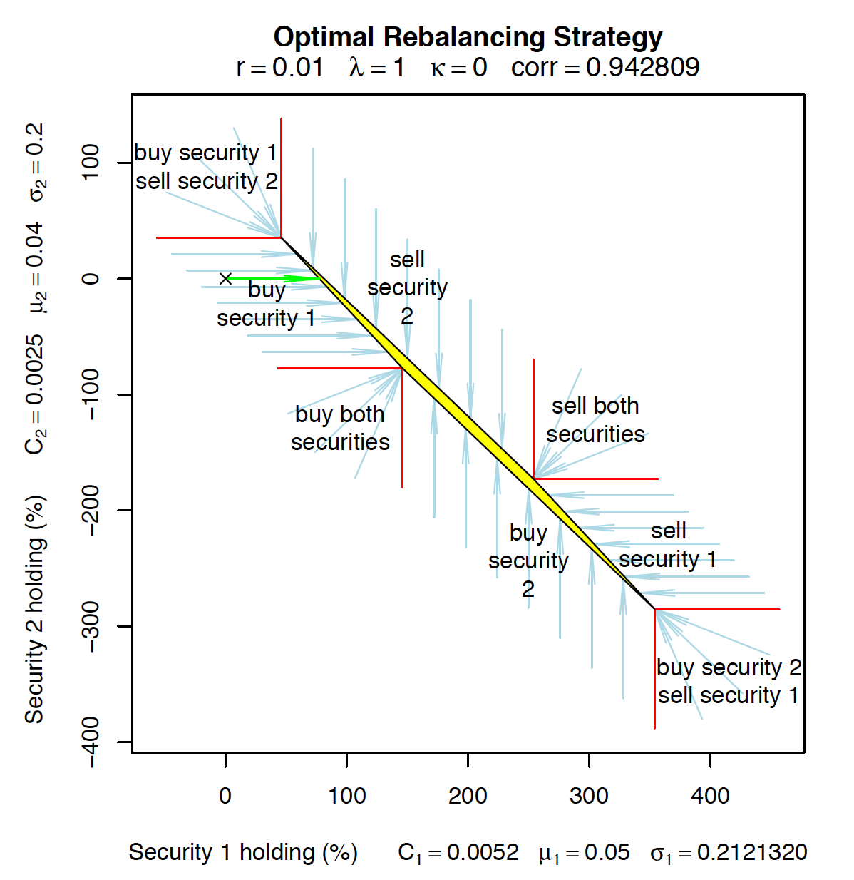
Futures Overlay
Higher return from the underlying equities than synthetic equity
  Active management
  Cost of rolling the futures
  Tax-timing advantages to equity
Optimal strategy: asymmetric
  Sell futures to correct for overexposure
  Buy underlying equities to correct for underexposure
Notes:
The optimal strategy is an asymmetric strategy typically selling futures to correct for overexposure to market risk but buying underlying equities to correct for underexposure to market risk.
Selling futures allows us to keep the alpha on the exposure we are eliminating, while buying equities allows us to gain alpha on the exposure we are taking on. (need to look at)
Generally, we might expect the return on the underlying equities to be higher

Slide 11
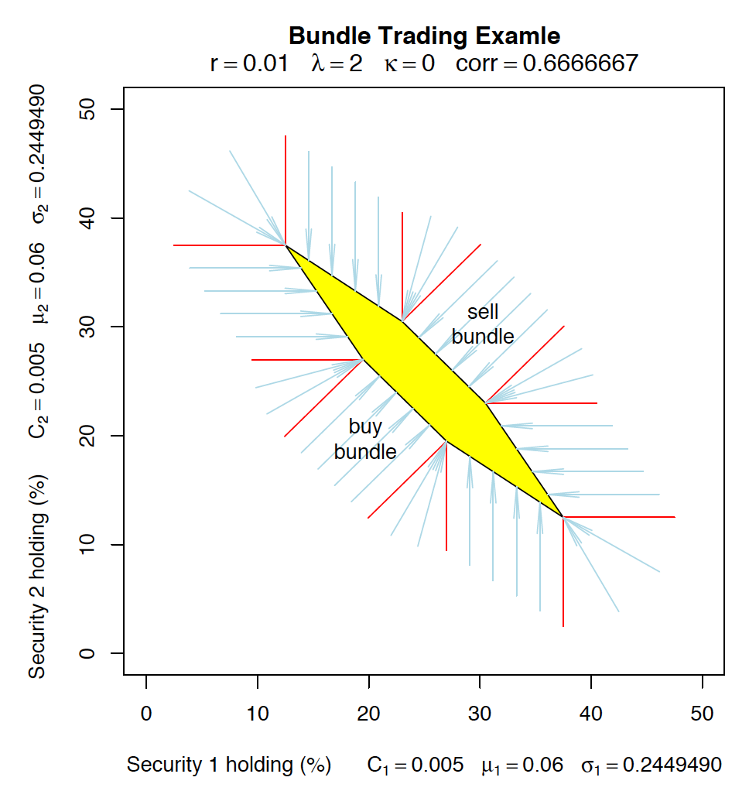
Bundles Trading
Cost-effective
More complex trading pattern
  Simultaneous buys and sells of different individual securities to compensate for imbalances caused by trading the bundle
Notes:
with an additional opportunity to trade a portfolio of the two assets at a cost of .0035.

Slide 12
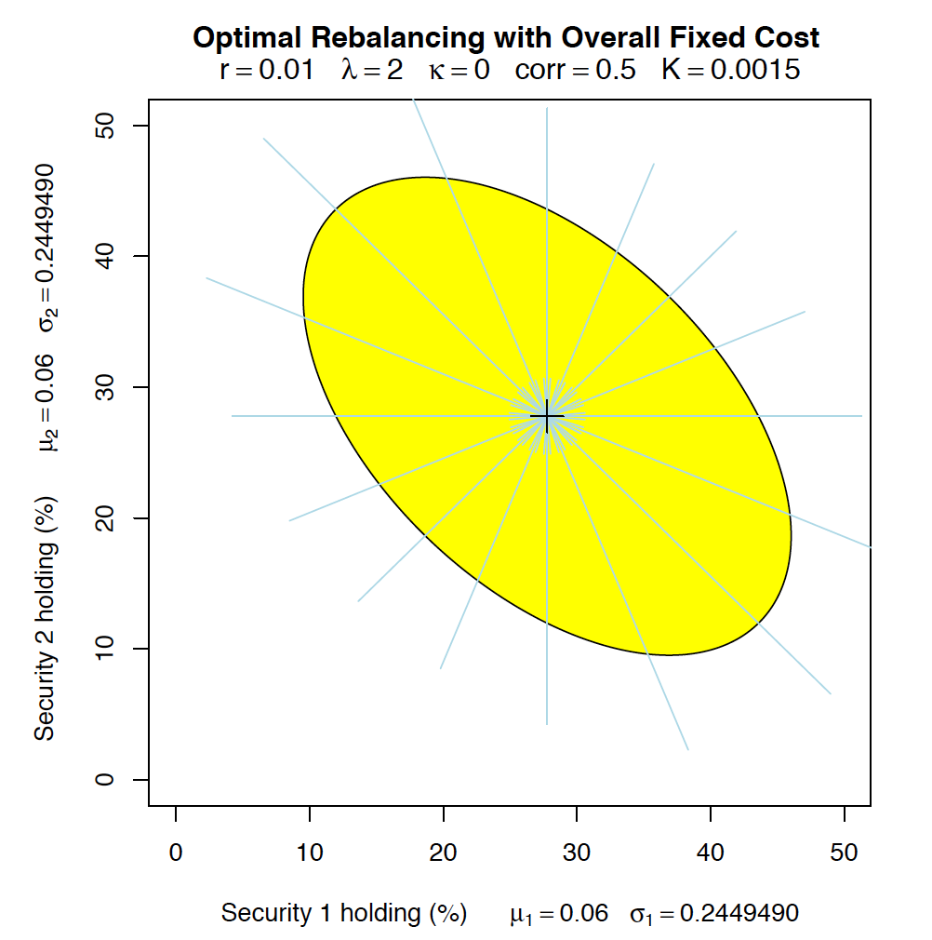
Overall Fixed Costs
Same ideal portfolio
Utility of not trading VS Utility of trading to the ideal point with the fixed cost
Optimal to trade when outside the indifference curve (ellipse) and not trading inside
Notes:
The size of the trading region is proportional to the square root of the trading cost, since the utility loss in any direction is proportional to the squared distance from the optimum.
If the asset returns were uncorrelated with symmetric covariances, the non-trading region would be a circle.

Slide 13
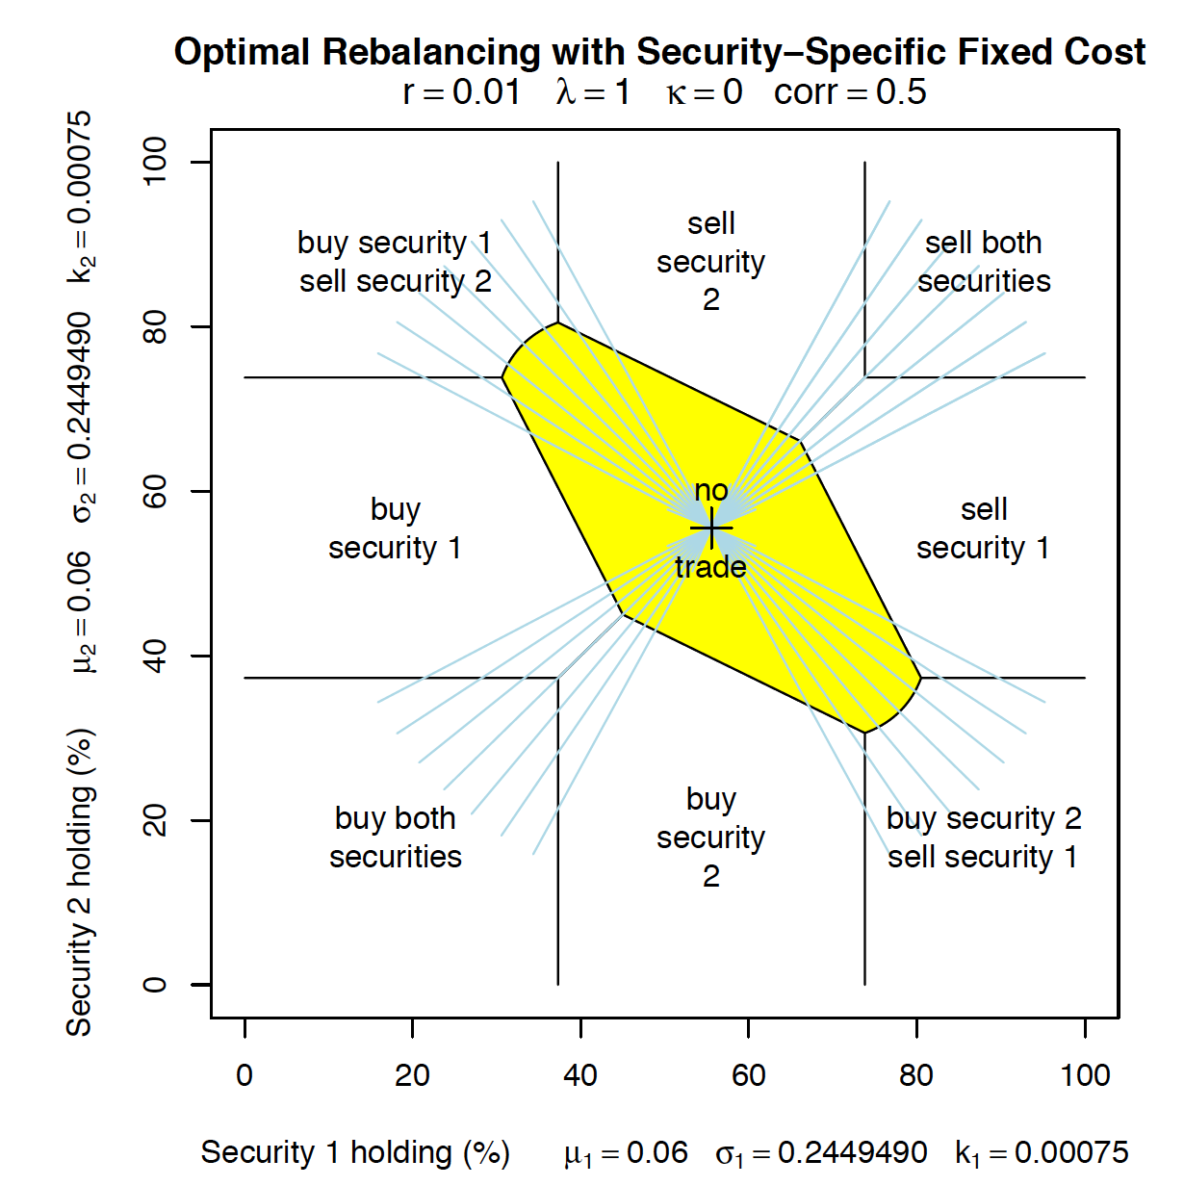
Security-Specific Fixed Costs
Comes from a due diligence requirement to monitor or document any security
A complex combinatorial problem: each possible set gives different overall nonconcave objective functions
More general without assuming the starting position is in cash
Notes:
From the regions in the corner, we trade both securities to the ideal point. From the regions on the right and left, we trade Security 1 but not Security 2 to a line going through the ideal point. This would be a vertical line if we had no correlation, but has negative slope in our case.

Slide 14
Theoretical Analysis for Single Risky Asset

Slide 15
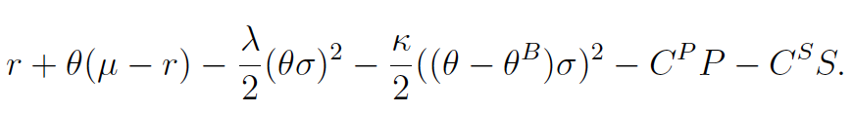

Problem 1: Proportional costs
Choose purchase P and sales S of the risky asset to maximize the utility function
  Expected return
  Disutility of taking on variance
  Penalty for tracking error
  Transaction costs
Notes:
Mean excess return on the risky portfolio; Variance of the portfolio return; Variance of deviations from the benchmark; Proportional transaction cost
Could add nonnegativity constraints for portfolio positions, a no-borrowing constraint or constraints on proportions in the stock, or risk limits.
Including 2 in the denominator makes the units the same as absolute risk aversion in a multivariate normal model with exponential utility over returns, and also cancels when we look at the ifirst-order conditions.
This term is probably controversial for academics because it depends on the benchmark B and not just on the distribution of returns. The dependence on the benchmark would be unnecessary and probably damaging in an ideal world, but does arise in practice and should be familiar to practitioners.
Costs are paid at end-of-period (or equivalently are converted to future values). Since utility is also measured in end-of-period return units, marginal utilities and costs are in identical units.

Slide 16
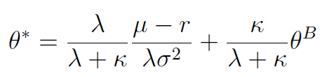
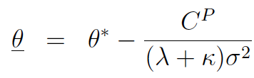
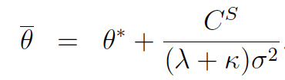
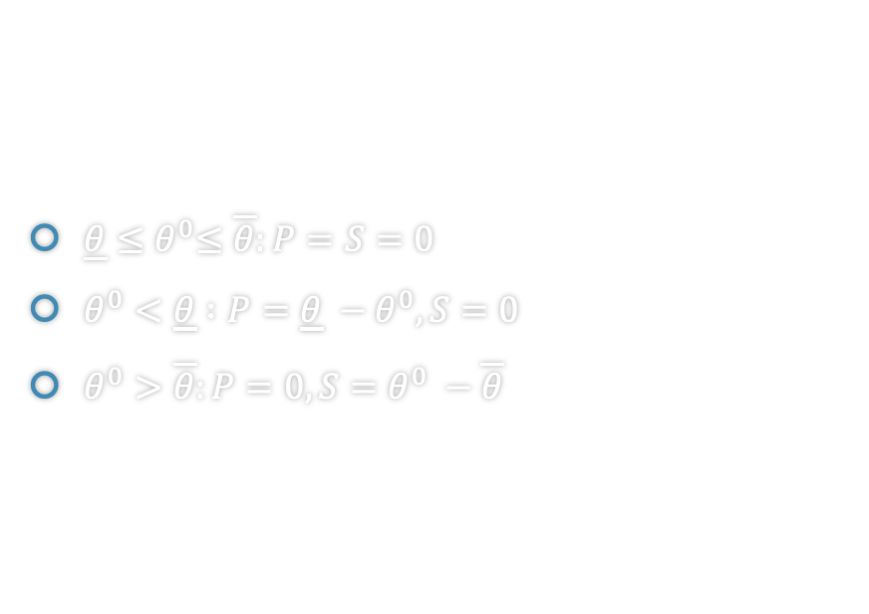
Solution: Proportional costs
$\underline{θ}{≤θ}^{0}≤\overline{θ}:P=S=0$
$θ^{0}<\underline{θ} :P=\underline{θ} −θ^{0}, S=0$
$θ^{0}>\overline{θ}:P=0, S=θ^{0} −\overline{θ}$
Notes:
Theta*: weighted average of the traditional mean-variance portfolio; Boudndary is proportional to the cost of trading
Having a non-trading region (instead of a single ideal point) follows because locally the cost of trading (which is linear or first-order) is larger than the cost of having the wrong portfolio (which is quadratic or second-order). It is conceivable that there could be second-order costs of trading (for example from price pressure not modeled in this article), but there are probably also proportional costs (e.g. from a bid-ask spread or fixed fee) and perhaps xed costs, both of which would be more important than the benets of rebalancing nearby the ideal point.
This is dierent from typical continuous-time models in which the size of the region is more than proportional to costs when costs are small (so that even a small cost induces a signicant non-trading region), as noted by Constantinides[1986]. In continuous-time models, it is not so urgent to trade immediately because it is possible to wait and perhaps a market move will do the trade for free. If not, then the trade will still be available soon (in the continuous-time model but not in a single-period model). At the optimum,the impact of transaction costs on optimal utility is of rst-order in a single-period model, which is di erent from traditional continuous-time models but similar to models with jumps (or perhaps more-to-the-point rst-order changes in the ideal portfolio weights

Slide 17

Problem 2: Fixed cost
Choose a quantity of the risky asset to maximize the utility function
Notes:
C > 0: xed cost incurred if trading
( 6= 0): indicator which is 1 if trade occurs and 0 if not.

Slide 18
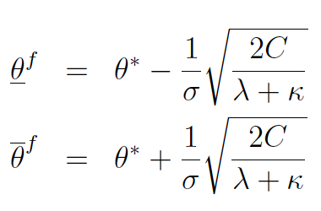

Solution: Fixed cost
$θ^{0}<{\underline{θ}}^{f}:P=θ^{∗}−θ^{0}, S=0$
$θ^{0}>{\overline{θ}}^{f}:P=0, S=θ^{0} −θ^{∗}$
Notes:
In this case, the size of the non-trading region is more than proportional to costs when costs are small. This is because the cost of being away from the ideal portfolio is second-order (quadratic), while the benet is zero-order(constant).

Slide 19
Conclusion & Discussion

Slide 20
Conclusion
Single-period rebalancing problem in a mean-variance framework
Variable cost models
Costly trading
It is optimal to trade only to the boundary of the non-trading region
Synthetic equity strategy
Asymmetric futures overlay strategy
Bundle trading
Fixed cost models
Any trade moves to inside the non-trading region if it is optimal to trade
  Overall fixed cost
  Security-specific fixed cost
Notes:
With only variable costs, any trading is to the boundary of the non-trading region, while fixed costs induce trading to the interior. With costly trading in futures and underlying, it might be optimal to use a synthetic equity strategy or an asymmetric futures overlay strategy that takes better advantage of extra expected return than traditional futures overlays.
In the variable cost models, it is optimal to trade only to the boundary of the non-trading region, since trading further would incur additional costs that are not justi-ed.1 With proportional costs, the cost of trading is additive (if all trades are in the same direction) or less than additive (if the second trade reverses the rst trade in some securities). If a candidate trade does not take us to the non-trading region, we could add on the additional trade we would make from that point and be better o. Or, if a candidate trade takes us beyond the boundary of the trading region, is better to trade along the line to the boundary because the part of the trade beyond the boundary is not justied. These arguments do not work for xed costs, because they rely implicitly on costs being additive for sequential trades along a line, and on costs being no more than additive for sequential trades that are not along a line.
In the models with xed costs, any trade moves to inside the non-trading region if it is optimal to trade at all. With only an overall xed cost, any nonzero trade moves to an ideal portfolio that would be held absent costs. This ideal portfolio is in the interior of the non-trading region because the value of trading from nearby is too small to cover the xed cost. With security-specic xed costs, any trade will take us to the interior of the nontrading region. However, dierent starting portfolios will cause us to trade to dierent target portfolios
If there are both xed and proportional costs of trading, then any trading will typically be to the interior of the non-trading region (due to the xedcost), although to dierent positions depending on the starting position (due to the variable part of the cost).

Slide 21
Discussion
Current analysis
It analyzes a one-period mean-variance portfolio rebalancing problem with proportional transactions costs and obtains instructive explicit solutions.
It provides a simplified and easy-understanding analysis framework (non-trading region) to analyze the similar problems and understand economics behind that in the real world.
It can be extended to the multi-period/continuous-time model
It does not consider market equilibrium and can be developed to consider the quadratic transaction costs
Rebalancing from any starting portfolio
Variable costs
Traditional literature
Purchase of a portfolio from scratch
Fixed costs
Notes:
Need to better understand non-trading region
The current analysis differs in two important ways from the traditional meanvariance literature on transaction costs. First, the traditional literature considered the purchase of a portfolio from scratch, while the current analysis rebalancing from any starting portfolio. Second, we focus primarily on variable costs rather than fixed costs.

Slide 22
Thanks!
Questions?

